Slide 1
Machine learning
Overview
Notes:
Are your classroom colors different than what you see in this template? That’s OK! Click on Design -> Variants (the down arrow) -> Pick the color scheme that works for you!
Feel free to change any “You will…” and “I will…” statements to ensure they align with your classroom procedures and rules!

Slide 2
Machine Learning
Machine learning teaches computers to recognize patterns and make decisions automatically using data and algorithms.

Slide 3
Types of Machine Learning
Supervised Learning: Trains models on labeled data to predict or classify new, unseen data.
Unsupervised Learning: Finds patterns or groups in unlabeled data, like clustering or dimensionality reduction.
Reinforcement Learning: Learns through trial and error to maximize rewards, ideal for decision-making tasks.

Slide 4
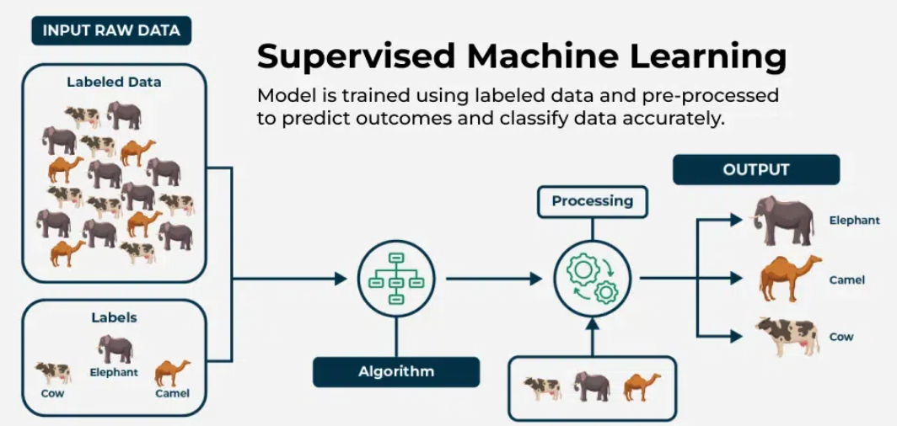
Supervised Learning
Supervised learning algorithms are generally categorized into two main types:
Classification - where the goal is to predict discrete labels or categories
Regression - where the aim is to predict continuous numerical values.

Slide 5
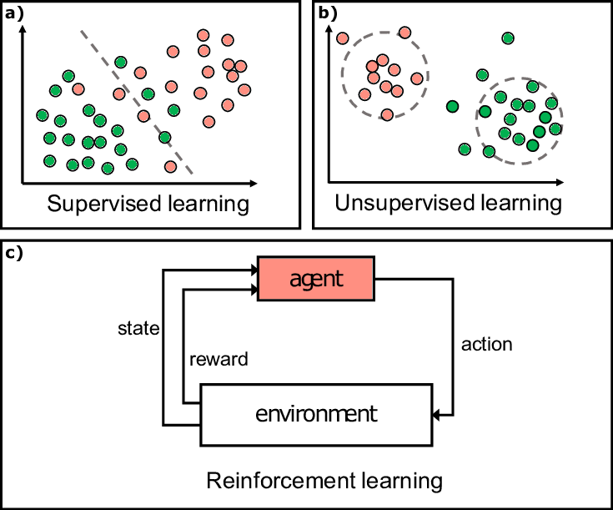
Types of machine Learning

Slide 6
Decision Tree Regressor
A Decision Tree for regression is a model that predicts numerical values using a tree-like structure.
It splits data based on key features, starting from a root question and branching out.
Each node asks about a feature, dividing data further until reaching leaf nodes with final predictions.
To get a result, you follow the path matching your data’s features from root to leaf.

Slide 7
Dataset Used
To demonstrate our concepts, we’ll work with standard dataset .
This dataset is used to predict the number of golfers visiting on a given day and includes variables like weather outlook, temperature, humidity, and wind conditions.

Slide 8
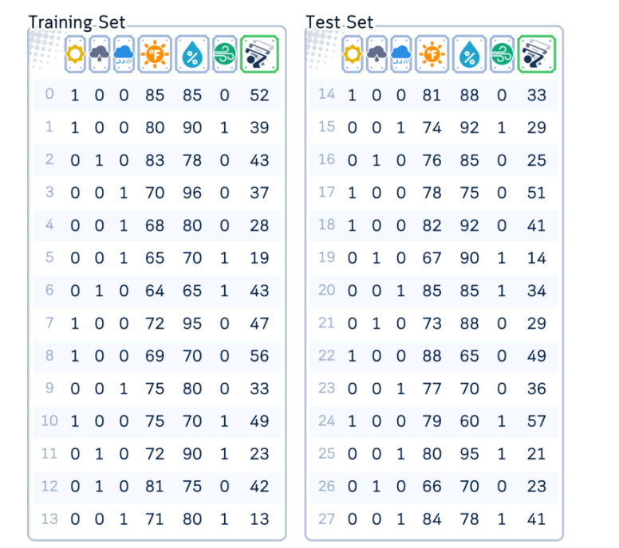
How dataset Looks Like?

Slide 9
Codding Part
Let’s create a dataset

Slide 10
Main Mechanism
The Decision Tree for regression operates by recursively dividing the data based on features that best reduce prediction error.
Here’s the general process:
Begin with the entire dataset at the root node.
Choose the feature that minimizes a specific error metric (such as mean squared error or variance) to split the data.
Create child nodes based on the split, where each child represents a subset of the data aligned with the corresponding feature values.
Repeat steps 2–3 for each child node, continuing to split the data until a stopping condition is reached.
Assign a final predicted value to each leaf node, typically the average of the target values in that node.

Slide 11
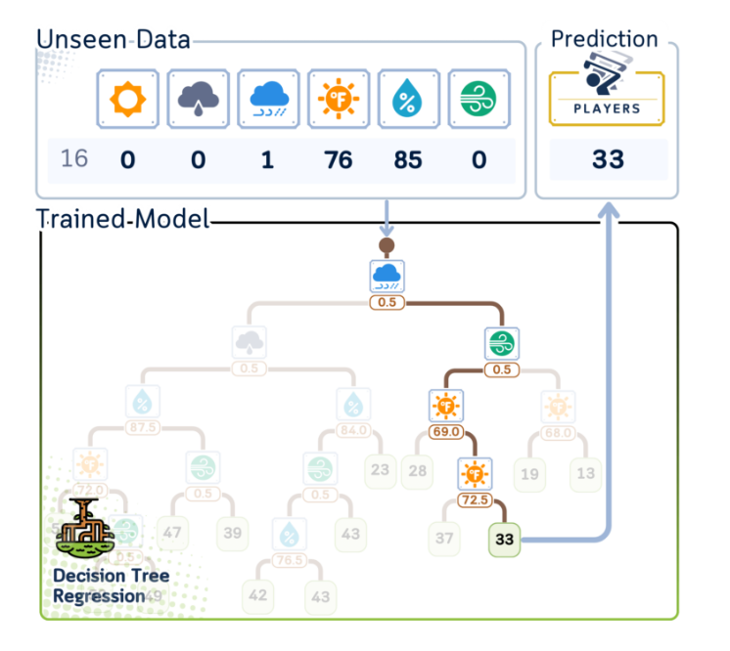
Oops!! Problem with Algorithm

Slide 12
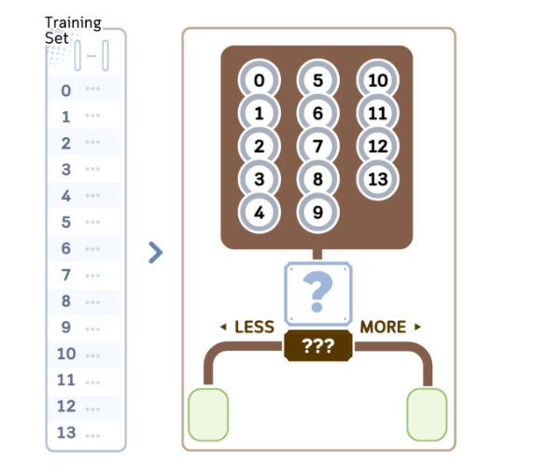
Training Steps
We will explore the regression part in the decision tree algorithm CART (Classification and Regression Trees). It builds binary trees and typically follows these steps:
1.Begin with all training samples in the root node.

Slide 13
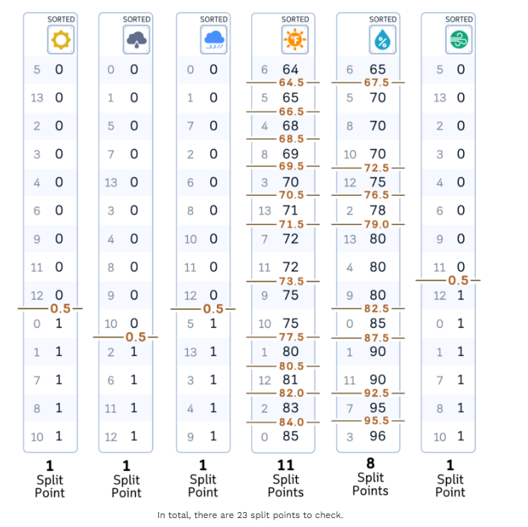
Sorting
2.For each feature in the dataset: a. Sort the feature values in ascending order.
b. Consider all midpoints between adjacent values as potential split points.

Slide 14
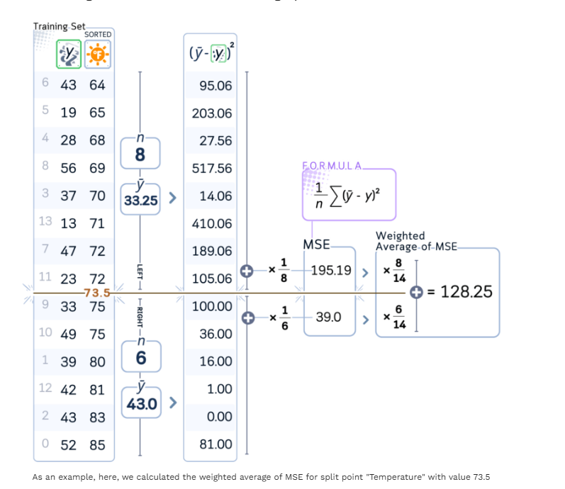
For each Split point calculate the MSE
For each potential split point:
Calculate the mean squared error (MSE) of the current node.
Compute the weighted average of errors for the resulting split.

Slide 15
Confusing ? Lets Implement it
Coding part

Slide 16
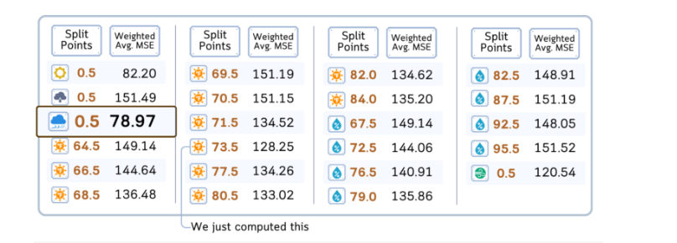
After evaluating all features and split points, select the one with lowest weighted average of MSE.

Slide 17
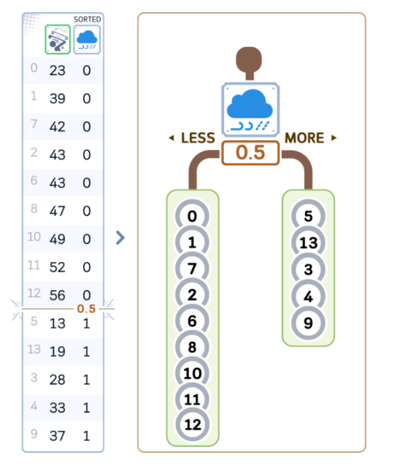
Create two child nodes based on the chosen feature and split point:
Left child: samples with feature value <= split point
Right child: samples with feature value > split point

Slide 18
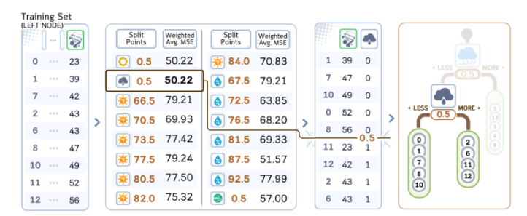
Recursively repeat steps 2–5 for each child node. (Continue until a stopping criterion is met.)

Slide 19
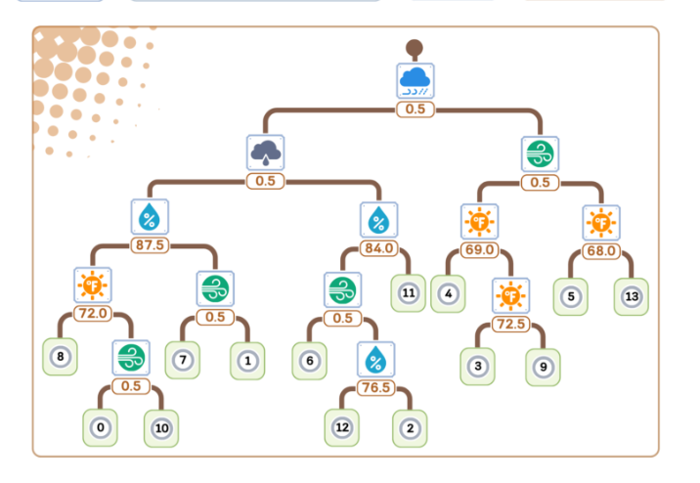
Let’s Visualize this:

Slide 20
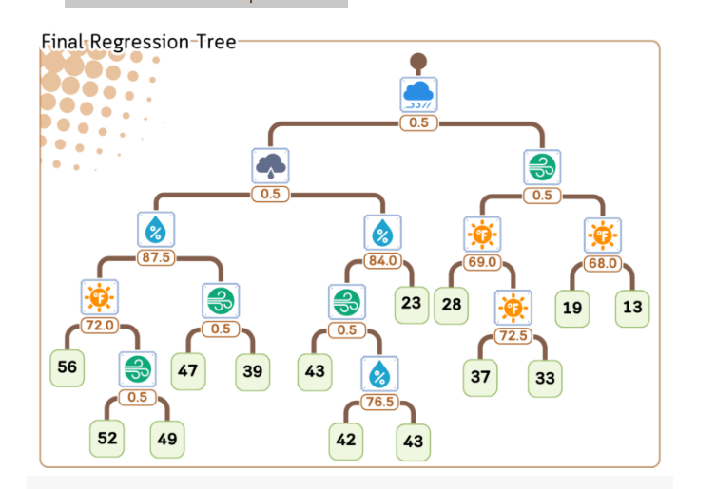
At each leaf node, assign the average target value of the samples in that node as the prediction.

Slide 21
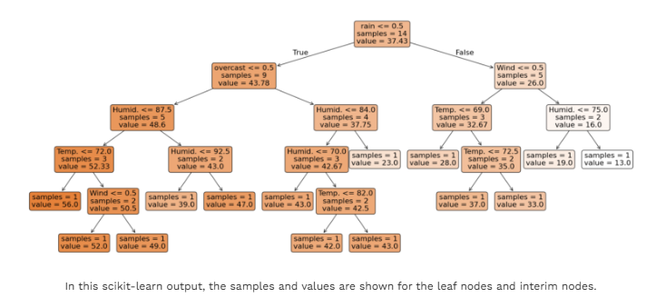

Slide 22
Regression/Prediction Step
Here’s how a regression tree makes predictions for new data:
Start at the top (root) of the tree.
At each decision point (node):
Look at the feature and split value.
If the data point’s feature value is smaller or equal, go left.
If it’s larger, go right.
Keep moving down the tree until you reach the end (a leaf).
The prediction is the average value stored in that leaf.

Slide 23
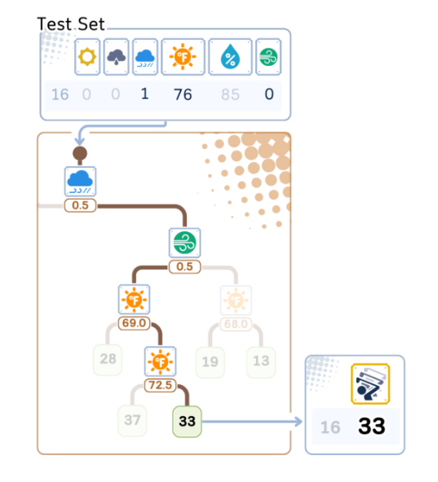
Regression Prediction Steps:

Slide 24
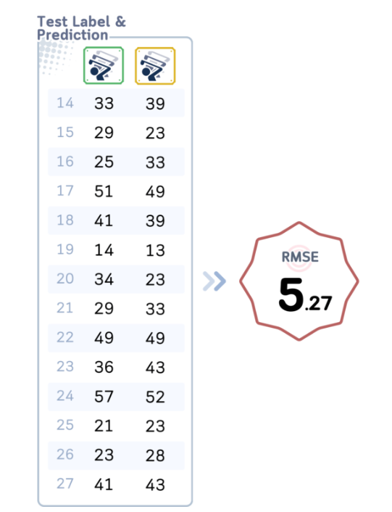
Evaluation Steps

Slide 25
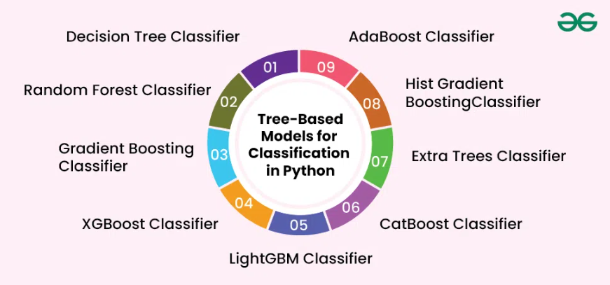
Tree Based Classifiers

Slide 27
Thank You !!!!

